Slide 1

LHL – Tableau Project Tuberculosis Burden by Country
Zara Faraz

Slide 2
PROJECT GOAL
“TB” is short for a disease called tuberculosis. TB is spread through the air from one person to another. TB germs are passed through the air when someone who is sick with TB disease of the lungs or throat coughs, speaks, laughs, sings, or sneezes.
TB is a global concern due to the increasing number of people infected. The pattern of increase is greatest in areas of the world with high HIV.
Explore how TB/HIV+ as a disease has evolved around the world and has there been any impact from global efforts to lower it’s spread.

Slide 3
PROCESS
Connected data to data source (single excel file)
Inspected data and adjusted data type (Geographical, date)
Explore the data
Cases with TB only
Cases with TB and HIV both
Identified important features
Population Number
Case Detection Rate
Case Prevalence Rate
Death Rate
Develop questions based on important features
Create Worksheets, dashboards and story to deliver findings

Slide 4
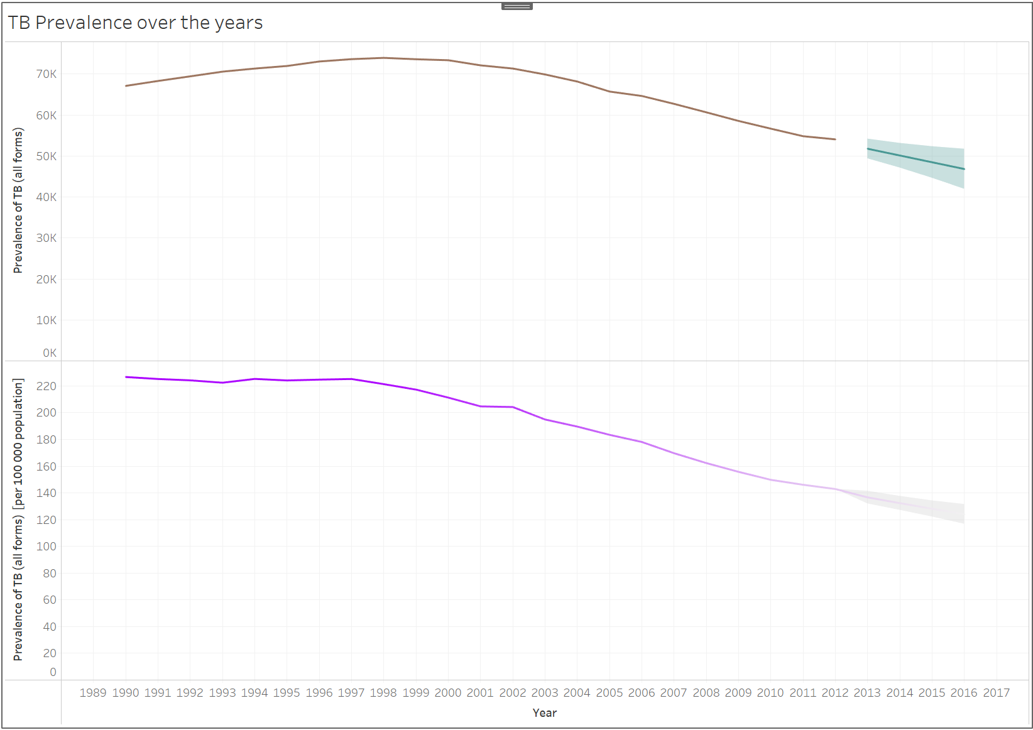
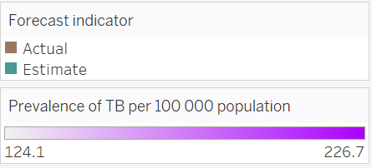
Q1 – How has TB disease prevailed over the years?
TB Prevalence (all forms)
Simple line graphs with forecast analysis. Used average value for each year.
We can see that TB Prevalence has reduced over time. This means that over the years, there are less and less people being affected by TB.
The forecast shows this number to further decline over the coming years.
TB Prevalence (per 100,000 population)
Simple line graphs with forecast analysis. Used average value for each year.
We can see that per 100,000 population on average the prevalence of TB has reduced over time.
The forecast shows this number to further decline in the future.
At this point in our analysis, we can see that the global effort to reduce TB prevalence have been successful.

Slide 5
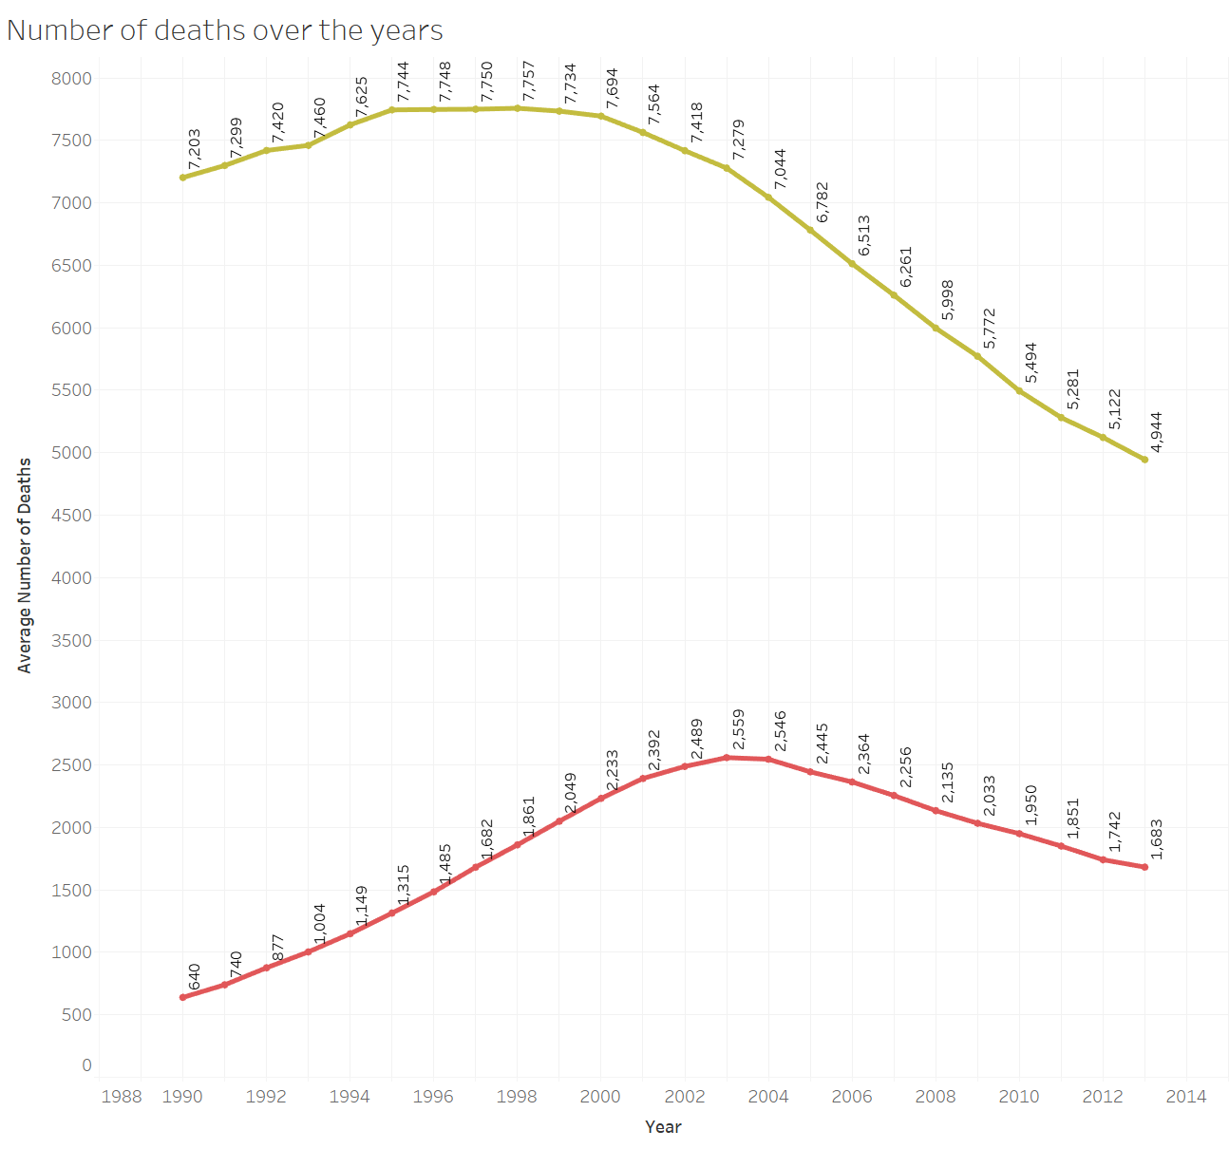

Q2 – How successful have been the global policies to curb TB?
Line chart represents the average number of deaths that happened in patients with only TB (Green Line) compared to patients with both TB and HIV+ (Red Line)
For patients with only TB, we can see that there is a general decline in the number of deaths over the years. However, for TB and HIV+ patients we can see a rise in number of death from year 2000 to 2004.
The global trend shows a decline in the number of death in both cases. This can be credited to the improved health policies, health funding and global efforts to reduce deaths resulting from this infectious diseases.
This reducing trend can also be linked to the previous graph. With a lower prevalence of TB, the death rate is also reducing. This would mean that more people are able to get access to the right medical treatments that helps them manage the disease rather than suffering from it.

Slide 6
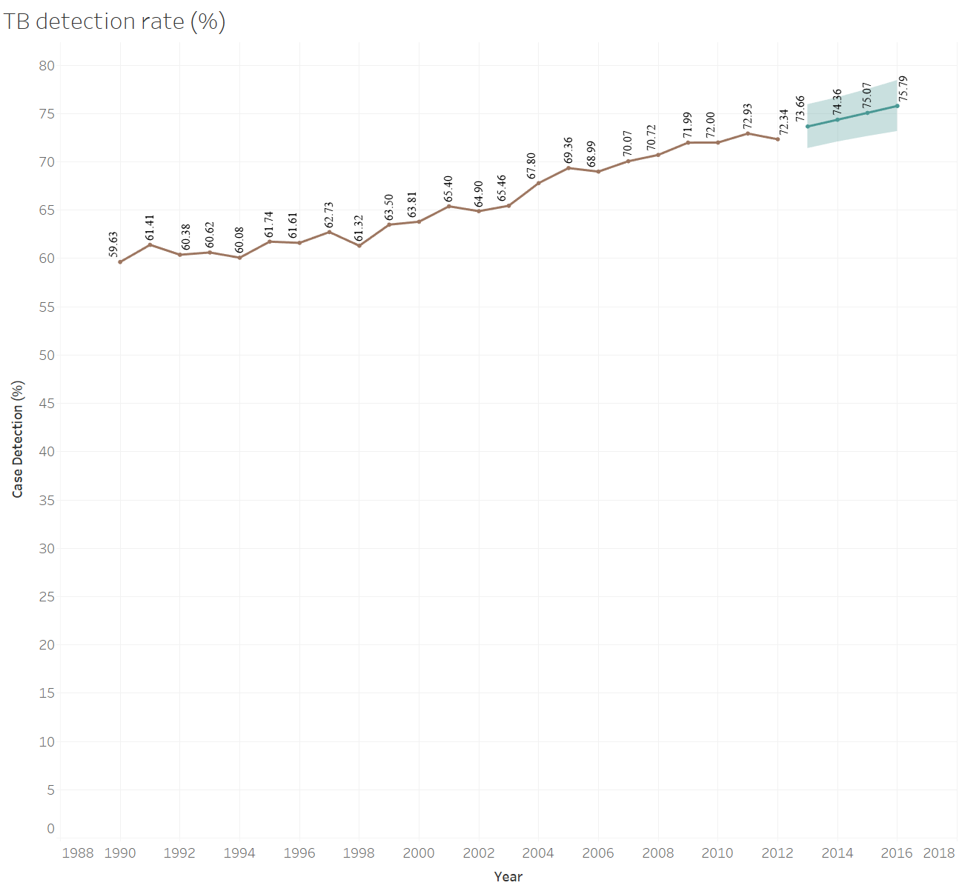
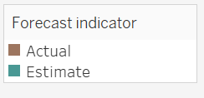
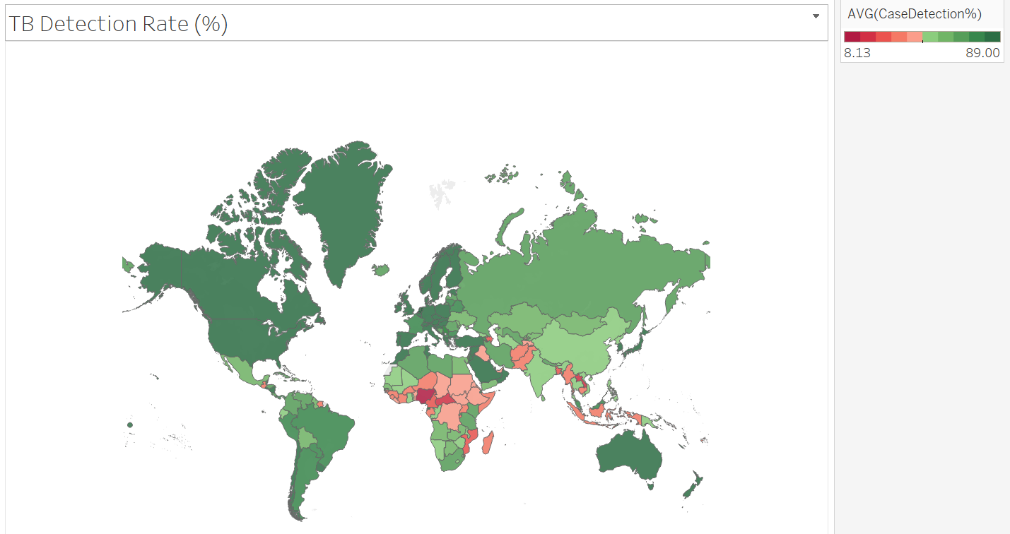
Q3 – Has there been any improvements in the diagnostics of TB disease?
Line chart represents the average percentage of cases successfully detected over the years. The chart also includes a forecast of the future detection rate.
From the chart we can observe a positive trend in the TB detection rate. This means that collectively the world figures have improved when it comes to detecting TB in patients. The forecast estimates also show that this trend will continue to improve in the coming years.
When we plot the detection rate against each country in our data set, we can see that countries that are developed have a higher detection rate as compared to developing or underdeveloped nations. This can be due to social, political and economic constraints faced by those countries.
This also means that the improved trend of case detection might be concentrated towards developed nations with more resources.

Slide 7
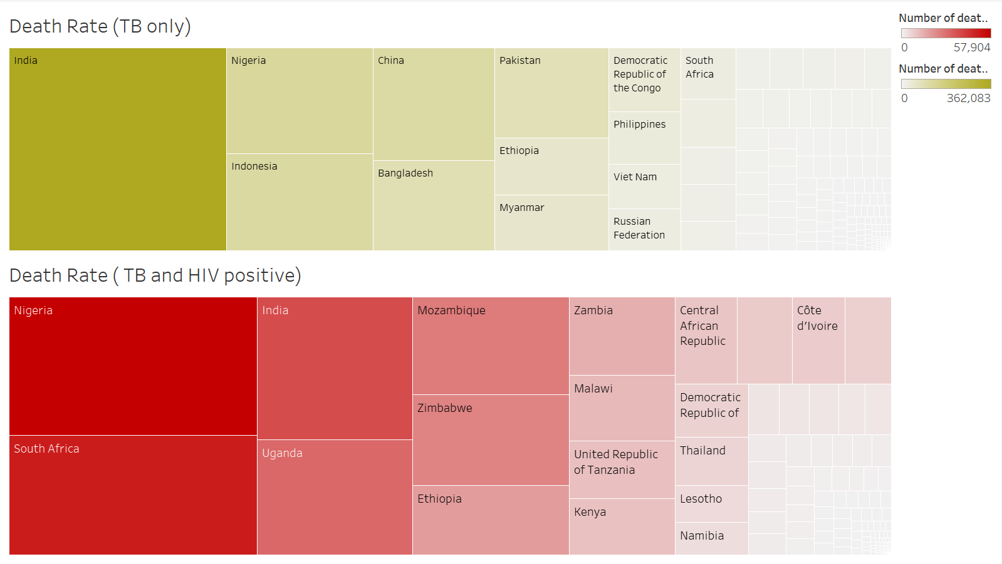
Q4 – Understand the distribution of death count in patients across the countries.
The tree maps on the right display the average number of deaths that resulted in each country in our data set over the number of year. There are 2 maps, the first one displays deaths resulting for TB only and the second one shows death for patients with both TB and HIV+.
Death Rate (TB only):
India has the highest number of deaths happening from TB.
Nigeria, Indonesia, China and Bangladesh are the next 4 countries that have the highest death rate from TB
Death Rate (TB and HIV+)
Nigeria and South Africa has the highest number of deaths happening from both diseases.
Followed by India and Uganda
Based on the visuals we can see that the higher death rates can be due:
Higher population → More and faster spread of the diseases.
Lack of medical → underdeveloped nations such as Nigeria might not have the right health care structure to deal with these diseases.
The maps also show that most of the developed nations are not identified in the map. This is because the death rate is very less (few 100 people). This is inline with the map shown in the last slide, that displays a higher detection rate for developed nations. The better the countries are at detecting communicable diseases the better they can manage the symptoms and prevent mortality.

Slide 8
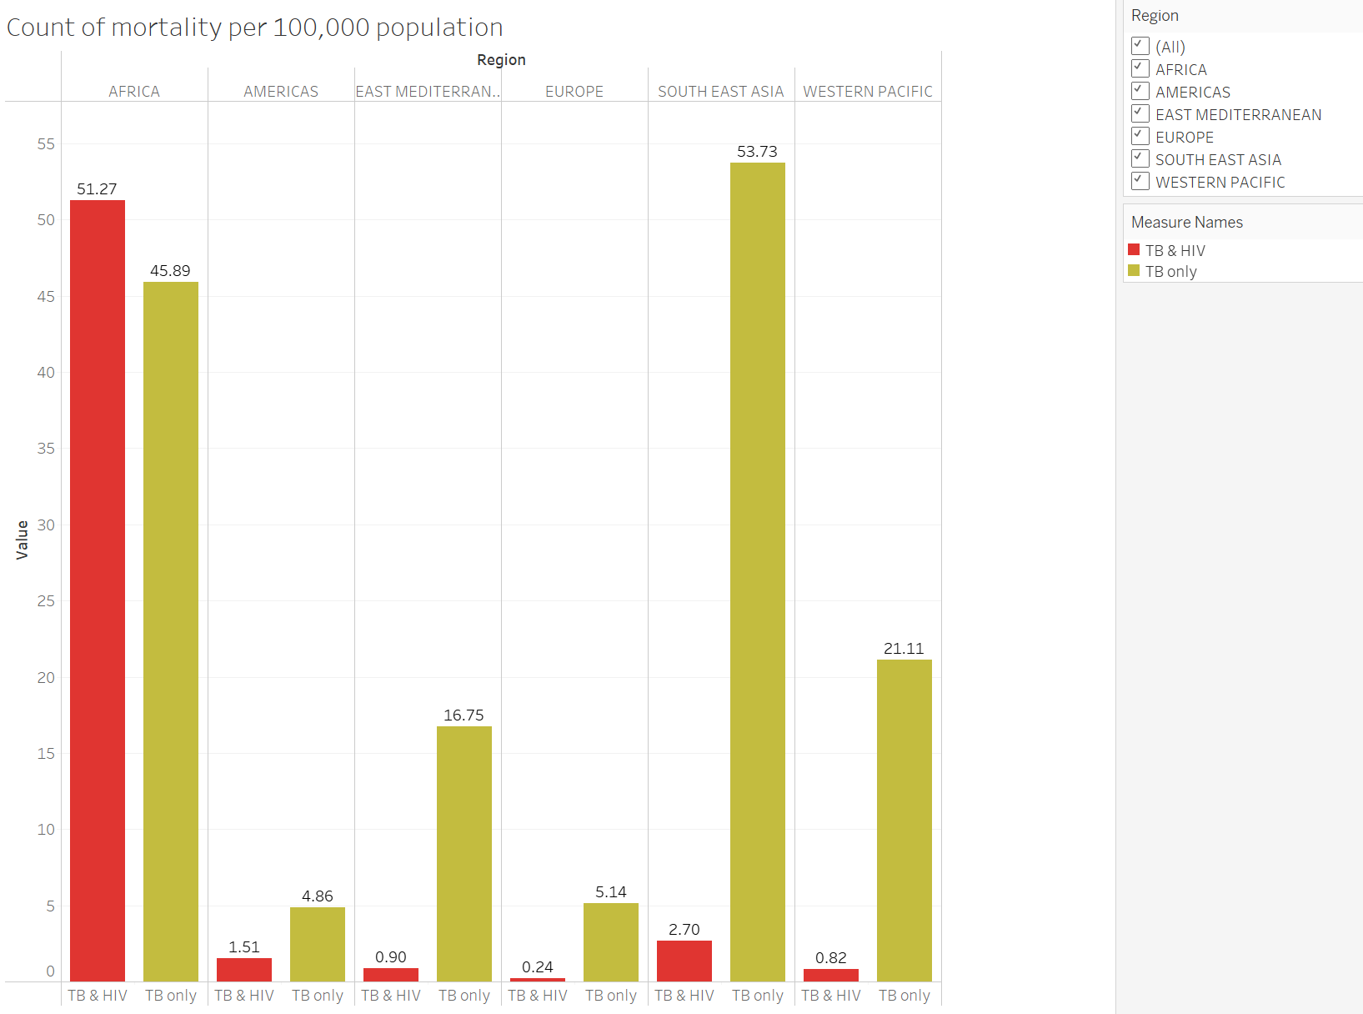
Q5 – Understand the distribution of mortality per 100,000 population across the regions.
The side-by-side bar chart shows the average mortality rate in each region of our data.
The green bars show the mortality rate for TB patients only
The red bars show mortality for patients with both TB and HIV+.
Mortality Rate (TB only):
TB mortality is highest in the Southeast Asia region followed by Africa region
Americas and Europe regions have the lowest mortality rate
Mortality Rate (TB and HIV+):
Mortality of patients with these 2 diseases is highest in the Africa region. This is mostly due to the access of resources and knowledge about the disease.
Overall other regions have less than 5% mortality rate from both diseases. This might be due to better policies in place for management of HIV disease.

Slide 9
Challenges/Future Goals
It would be ideal to have some sort of information on what the data represents (definition of each column)
I felt that there should have been a distinction between mortality and death columns in the data source. What is the difference between the 2 columns and the data within it.
The regions should have been identified in complete form like Africa instead of a code AFR.
The source of the data should be linked for better analysis.
If there was more time I would add other data sources like economic indicators (Income, GDP) and Health statistics of the countries to future analyse the data.
A great WHO resource for TB (https://www.who.int/teams/global-tuberculosis-programme/tb-reports)

